Slide 1
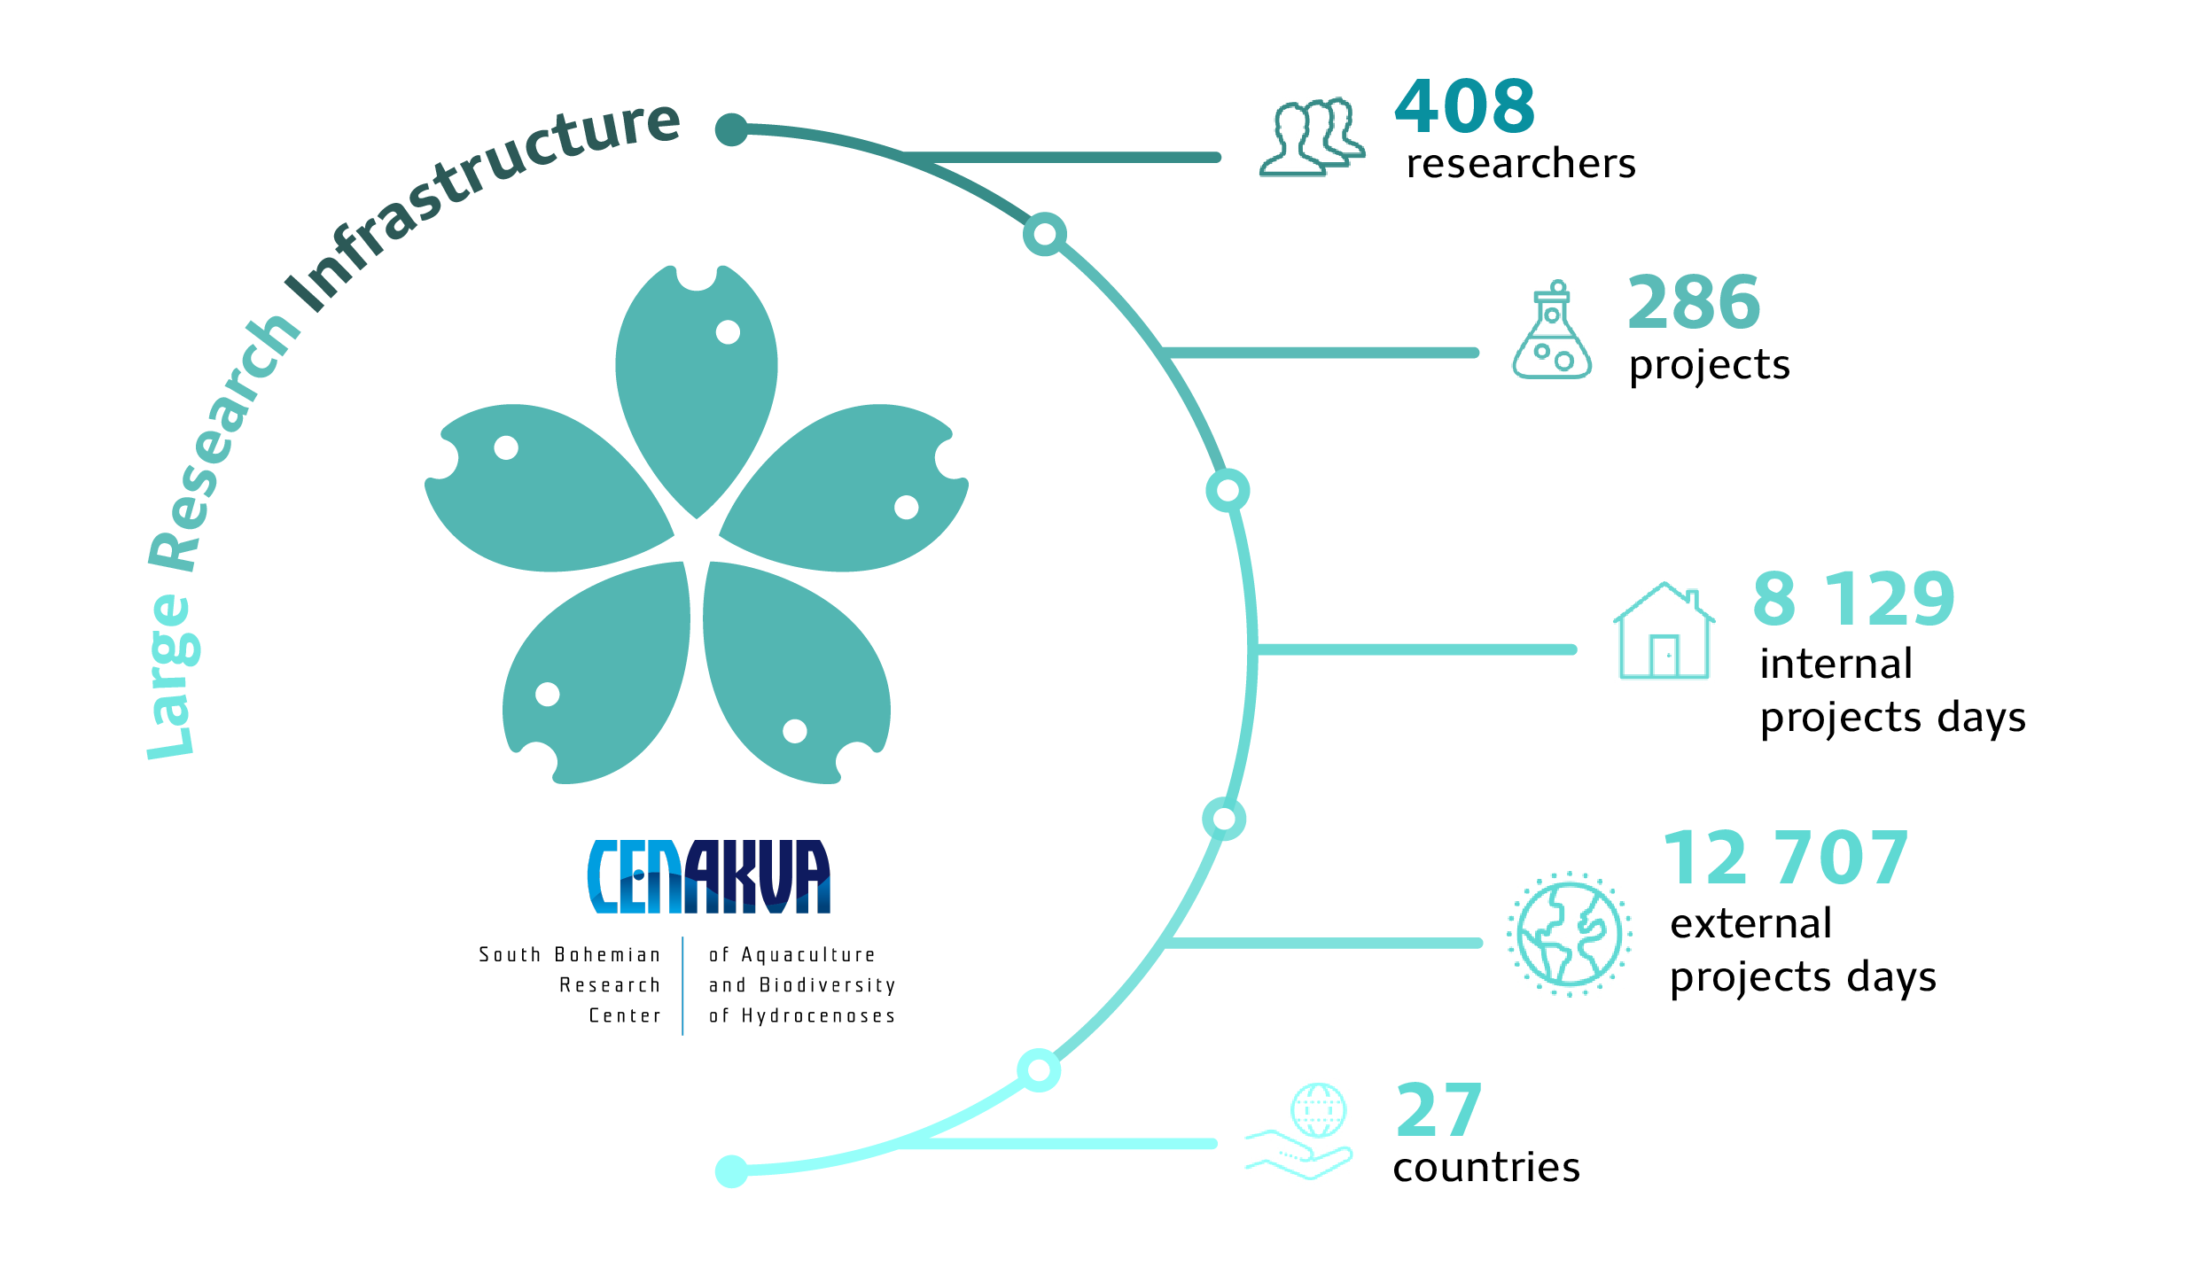
Large research infrastructure CENAKVA– OPEN ACCESS
South Bohemian Research Center of Aquaculture and Biodiversity of Hydrocenoses
Project No: LM2023038 LM2018099(2019-2022)
Provider: Ministry of education youth and sports
Website: CENAKVA, www.frov.jcu.cz
Contact person: Dipl.-Ing. Petr Císař, Ph.D.
Areas of cooperation:
Experimental ponds, outdoor tanks, RAS and aquarium rooms
Analysis of foreign substances
Growth tests
Gene bank
Capillary sequencing, flow cytometry
Water quality, management of feeding, nutrition, stocking densities
Monitoring systems
Microscopy
Feel free to sign up with your experiment!

