Slide 1
Using of live feed during effective intensive larvae culture
Carlos Yanes-Roca, Tomáš Policar and Aiman Imentai
www.frov.jcu.cz

Slide 2
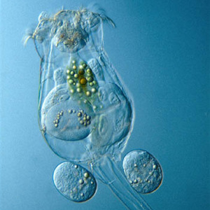
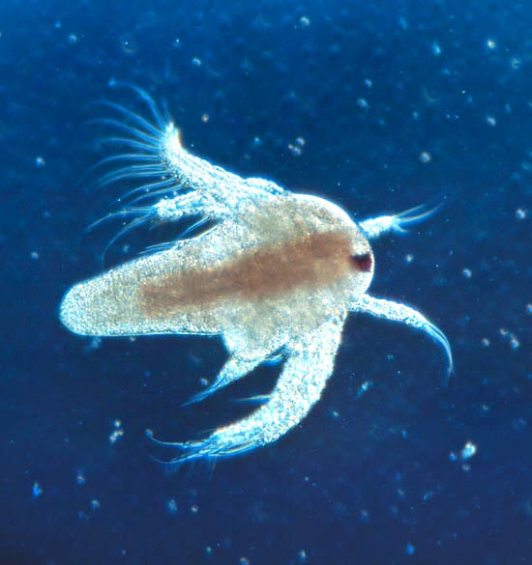
The most commonly used food organisms during intensive aquaculture
Artémia salina – Brine shrimp
Brachionus plicatilis - Rotifers
reefculture.wordpress.com
Brachionus plicatilis
Artemia salina

Slide 3
Live feed - Essential for yet barely developed larvae at the beginning of exogenous nutrition
-Endogenous feeding- utilization of nutrients from the yolk sac after hatching may take some time:
Rainbow trout: 2 - 4 weeks, -Burbot: 5-8 days (approx. 7 days) -Pikeperch (Zander): 3-5 days -Perch: 3 - 4 days, -Carp: 2 to 3 days -Tench: 4-6 days -Grass carp: 6-7 days
Depending on the species, water temperature, broodstock nutrition , the size of the yolk sac…
-The transition from endogenous to exogenous feeding is a very critical period for larvae. Larvae must be offered appropriate food, according to their ontogenetic development (the anatomical structure of the digestive tract and its degree of function).

Slide 4
Sorting of larvae at the beginning of exogenous nutrition - according to the structure and function of the digestive tract and different demands to the first exogenous nutrition
For groups:
Salmonid fishes - functional stomach and a well-developed digestive system produces enzymes allowing digest starter feed;
Catfish, African catfish, barbel - undeveloped stomach, have well developed gut with very good digestive and absorptive capability. They are able to receive and digest starter feeds;
Cyprinid fishes, European perch - underdeveloped and short intestine and hepatopankreat, low or no production of digestive enzymes that larvae must accept the exogenous food, very limited digestion and absorption of nutrients, rather large mouth, first exogenous nutrition for 3 - 7 days need to receive live feed with gradual shifting to start feeds in about 10-14 days;
Pikeperch, burbot, sea bass, sea bream and other marine fishes- gastrointestinal tract similar to group 3, although fish has a very small mouth, capable of receiving food at size of 150-200 μm, the first 3 to 5 days of exogenous nutrition require a small sized live food (rotifers), then for 6-10 days artemia with gradual shifting to start feeds.

Slide 5
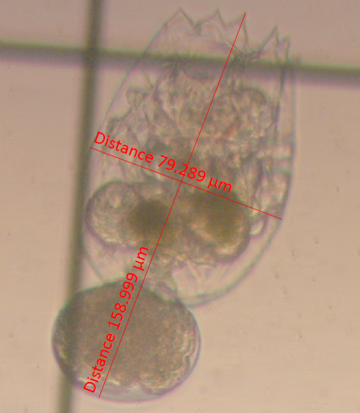
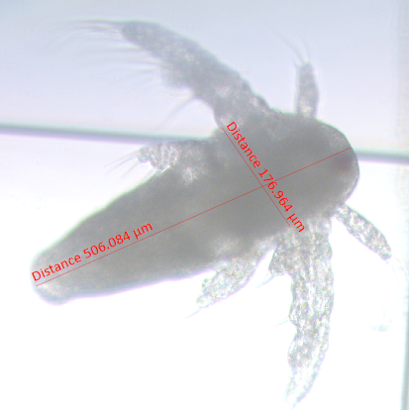
Differences between rotifers and artemia (Brine shrimp)
reefculture.wordpress.com
Brachionus plicatilis
Artemia salina
Brachionus plicatilis (159 µm)
Artemia standard instar I
(506,084 µm)
Characteristic | Rotifers | Artemia
Size | 100-340 µm, depending on species and development stage | 422-517 µm, depending on species and development stage
Salinity | Tolerance to a wide range of salinities | High salinity
Maturity stage | 18-72 hours | 3 to 6 weeks to reach maturity
Supply | Manipulated and regulated; reliable, depending on culture facilities | Harvested from natural resources and farming
Nutritional quality | Can be manipulated and regulated | Can be manipulated and regulated
Transmission of parasites and predators of fish larvae | Minimal | Minimal

Slide 6
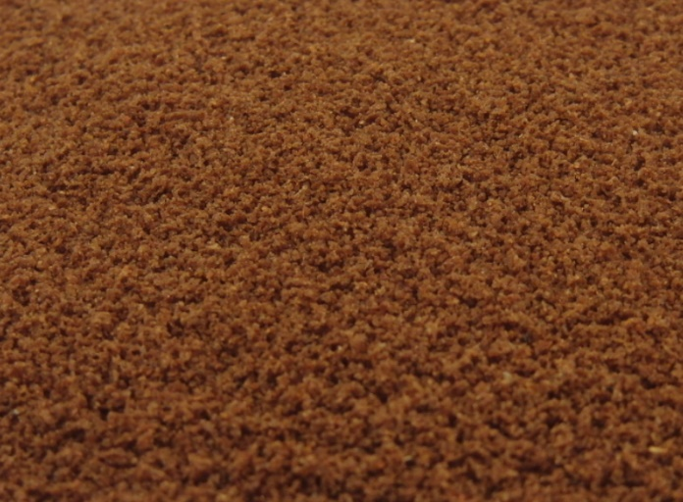
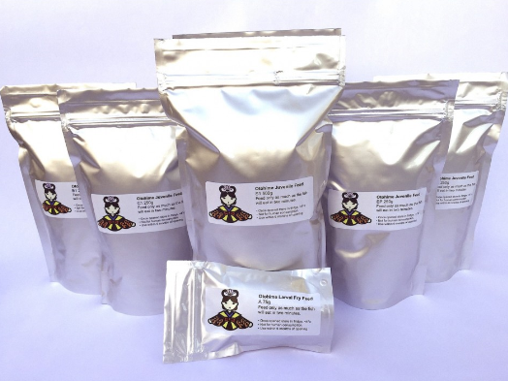
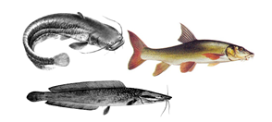
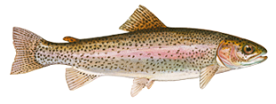
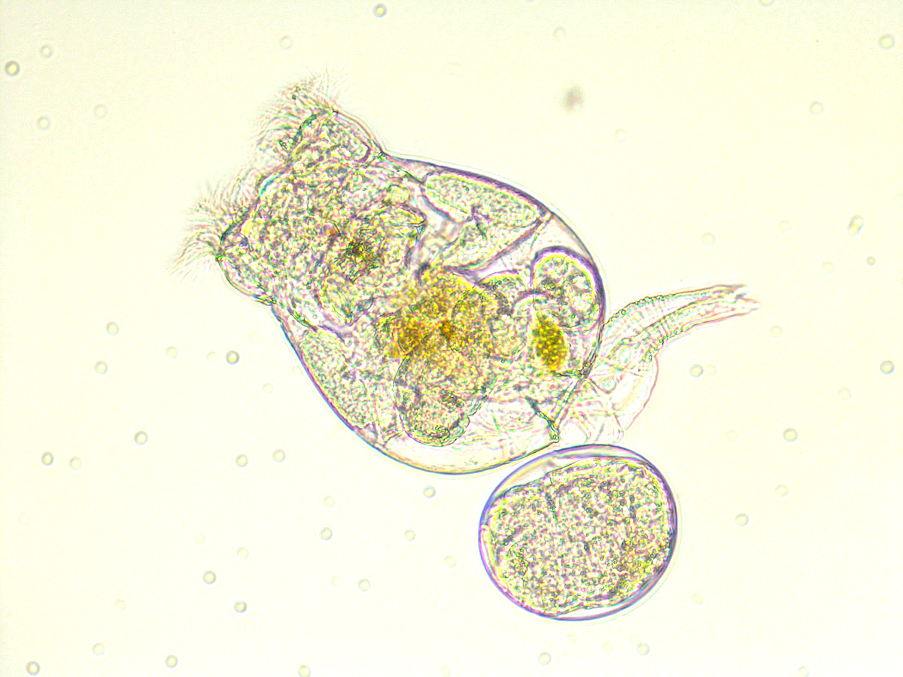
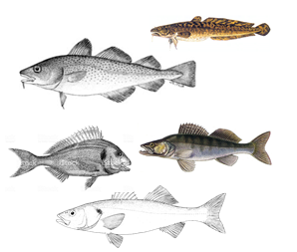
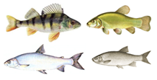
Sorting of larvae at the beginning of exogenous nutrition - according to different demands for the first exogenous nutrition

Slide 7
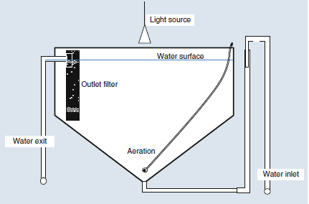
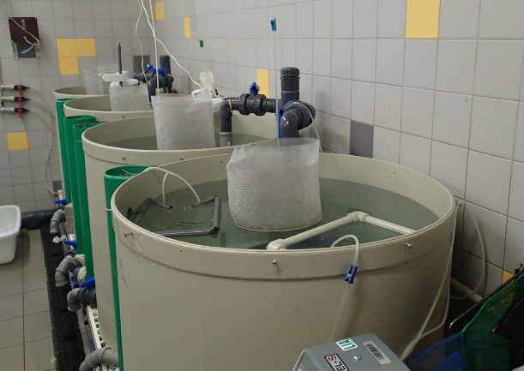
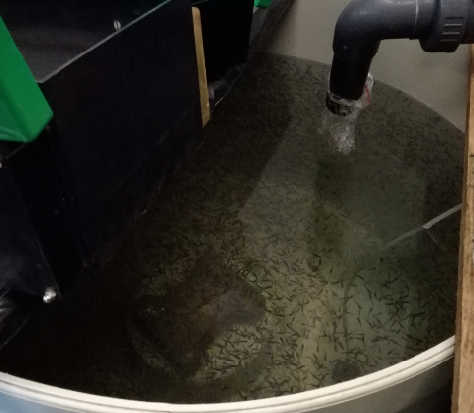
Larvae at the beginning of exogenous nutrition - specific rearing conditions
Tanks easy to clean, inflow of water from the bottom of the tank and drain at the surface (water has to carry food organisms and remove dirt from the surface),
Food organisms must move in the tanks and be attractive for larvae,
For longer and higher survival of rotifers and artemia in tanks, it is recommended to increase salinity of water (2 - 5 g.l-1)
There must be a sufficient number of food organisms for each individual,
Their applications at libitum at short intervals (less than 2 hours),
Feed is presented during day light (often 24 hours a day)
Application of rotifers during 3 to 5 days, then a combination of rotifers – artemia (3 - 5 days), followed by a combination of artemia and dry feed (starter), and finally the complete weaning of larvae for starter feed.

Slide 8
WEANING STRATEGY
The quantity of Rotifers/Artemia is gradually reduced while the quantity of dry diets is increased
Rotifers
Artemia
Dry diets

Slide 9
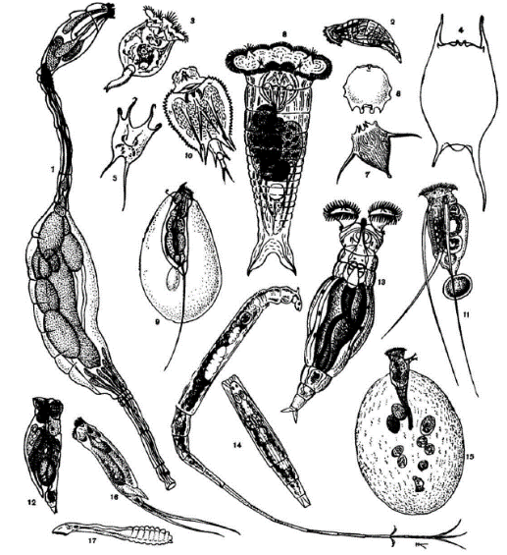
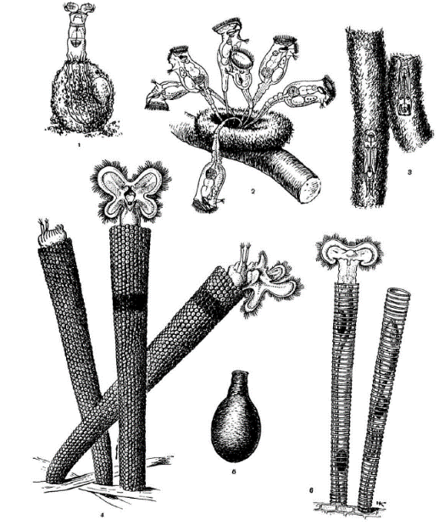
Use of Rotifers in aquaculture
There are around 2,000 species of rotifers worldwide,
Only 3 species (0.1%) are used for aquaculture purposes
Those are: Brachionus calyciflorus , B. rubens and B. plicatilis (brackish or marine species)
Their main features are:
- size of 150 - 250 μm,
- mobility in the water column,
continuous spawning,
easy of mass production,
short spawning interval,
high density,
high tolerance to environmental conditions,
simple nutrition,
commercial production,
low production costs,
The possibility of improving their nutritional profile
Absence of diseases in controlled conditions.

Slide 10
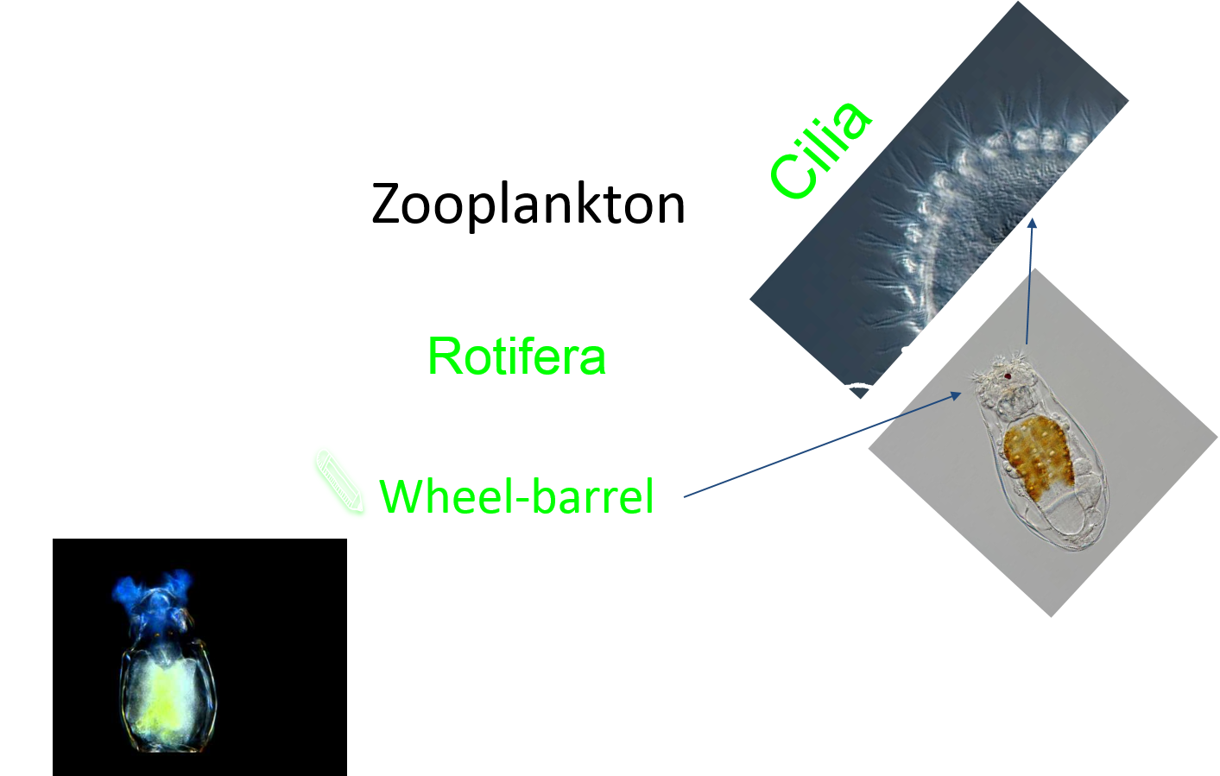
Brackish rotifers – Brachionus plicatilis

Slide 11
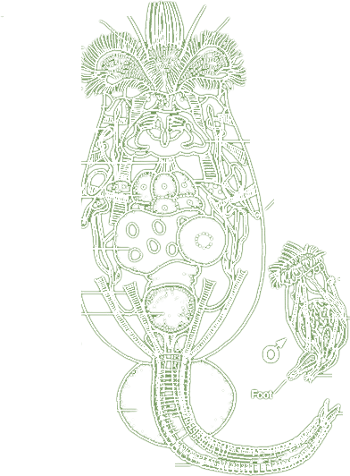
Anatomy of Brachionus plicatilis
Sensory bristle
CORONA
Lorica
Esophagus
Stomach
Vitellarium
Bladder
Testis
Penis
Embryo
SIZE: 150 TO 500 µm
Foot

Slide 12
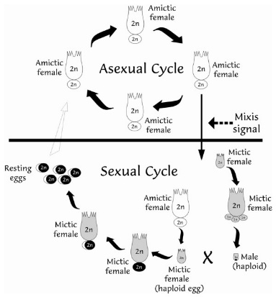
Reproduction of Brachionus plicatilis
Under favorable conditions (salinity 35 gl-1, enough algae, water temperature 25 ° C, low ammonia content and 24 h light), only amyctic females producing diploid embryos are found (in their life of 7 - 15 days approximately 20 pcs) . Rotifers can be achieved under optimal conditions, densities up to 1500 - 2000 individuals per 1 ml.
Under unfavorable conditions - the presence of males of only a third the size than females without the gastrointestinal tract, their mission is to produce sperm and fertilize females (producing haploid ovum) to make protected cysts.
PARTHENOGENESIS
(ASEXUAL)
SEXUAL DIMORPHISM

Slide 13
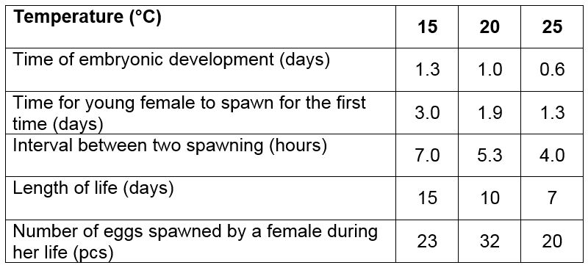
Reproduction characteristics of Brachionus plicatilis
under different water temperatures
PARTHENOGENESIS
(ASEXUAL)
SEXUAL DIMORPHISM

Slide 14
Culture methods of Brachionus plicatilis
Two main Methods
Batch Culture
Continuous Culture

Slide 15
- Limited time and culture place / equipment, - Duration: 6 to 10 days, Maintain a constant rotifer density with increasing water volume and feeding, - Full culture harvest.
Batch culture of Brachionus plicatilis
Characteristics:

Slide 16
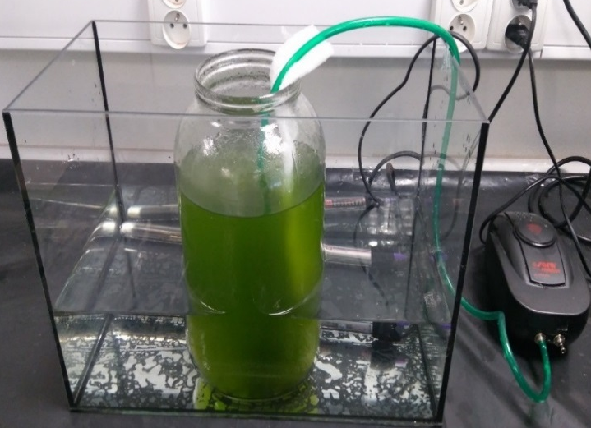
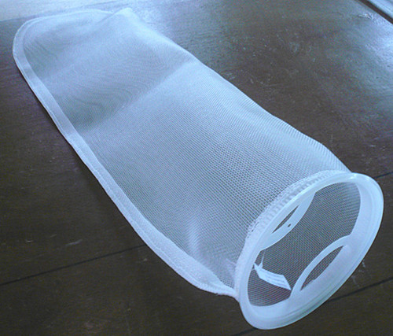
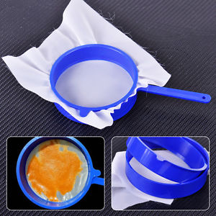
Batch culture of Brachionus plicatilis
A
B
Cysts of B. plicatilis
Setup of rotifer culture
Collector sieve
60 L culture tanks
C
D

Slide 17
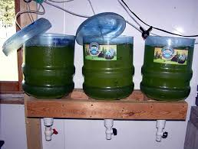
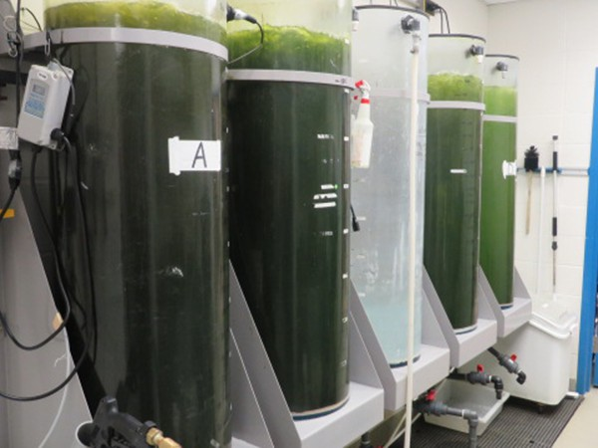
Batch culture of Brachionus plicatilis

Slide 18
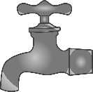
Continuous culture of Brachionus plicatilis
Characteristics:
Special recirculating aquaculture system (RAS),
In order to maintain optimum environmental conditions due to biological filtration,
Removing waste materials,
Keeping a constant volume with increasing density of rotifers,
At a high density of rotifers, the sampling of feeding larvae and the discharge of water,
Use for 30 days, then reboot again.
30 DAYS

Slide 19
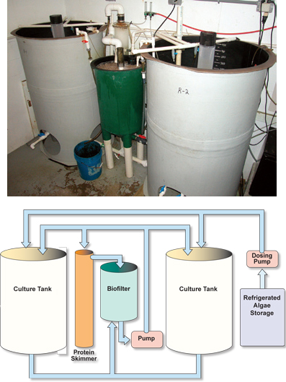
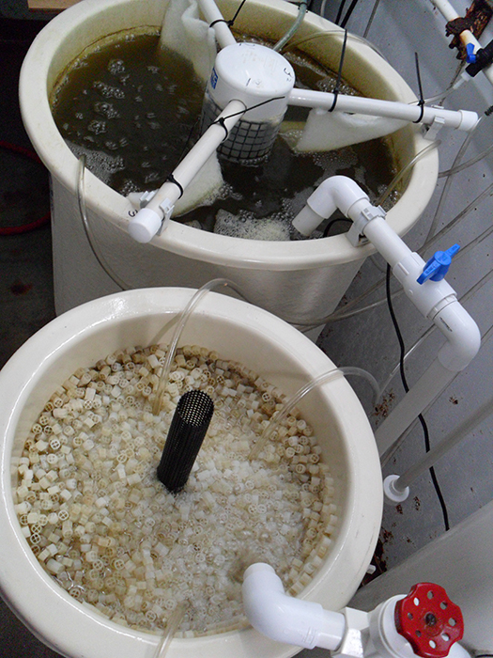
Rotifer tank
Biofilter
Continuous production of Brachionus plicatilis

Slide 20
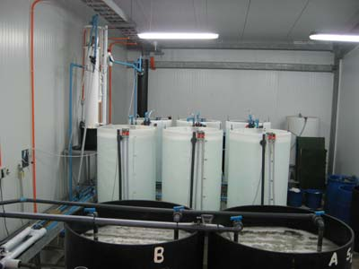
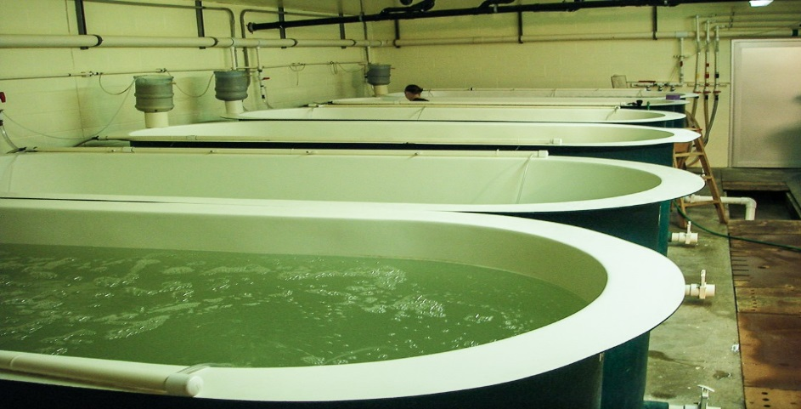
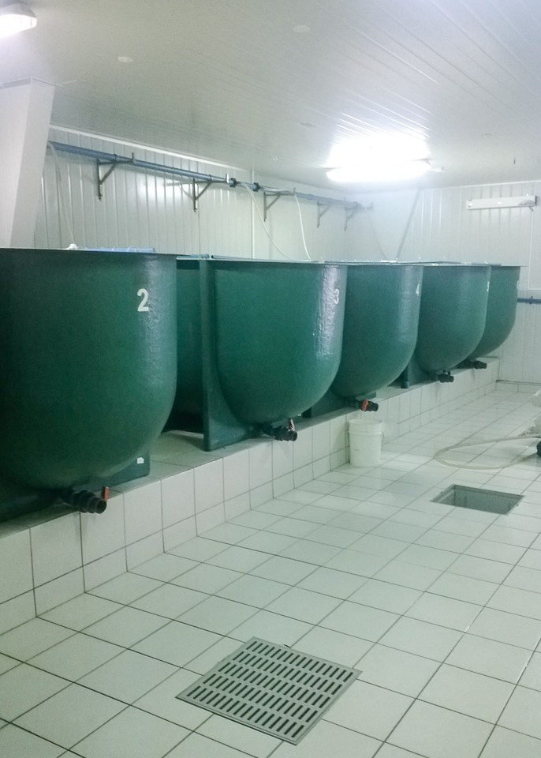
Continuous production of Brachionus plicatilis
in fish farms
Aqua Partners, Denmark
Sablefish, Canada
Chile

Slide 21
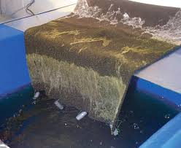
Special floss for solid removal
2. Remove and rinse
Floss
Into the tanks
Continuous production of Brachionus plicatilis
- Removal of solid

Slide 22
Culture conditions for Brachionus plicatilis
Water temperature 15 – 30°C,
Water salinity 20 – 40 g.l⁻¹,
pH 6,5 – 8,5
Concentration of ammonia high tolerance
Aeration very strong
Daily feeding with algae
Light regime 24 hours per day without any negative effect of shorter light day

Slide 23
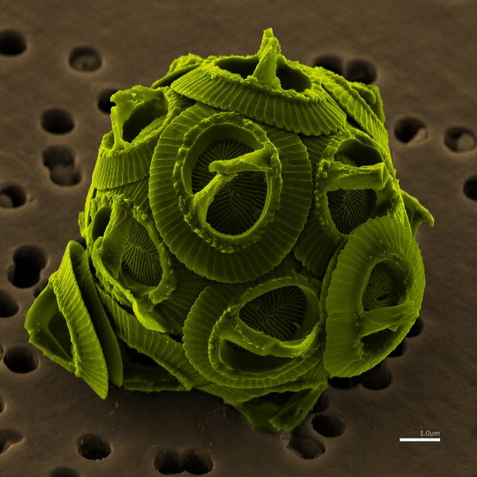
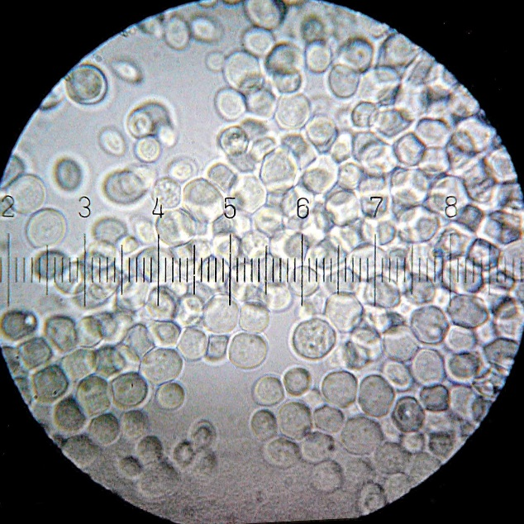
Suitable feed for Brachionus plicatilis
Phytoplankton- Alage
Yeast (droždí)

Slide 24
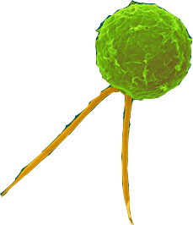
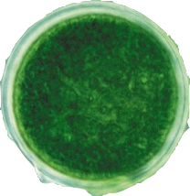
Two main algae species:
Algae as suitable feed for Brachionus plicatilis
Nannochloropsis oculata
Isochrysis galbana

Slide 25
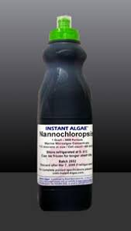
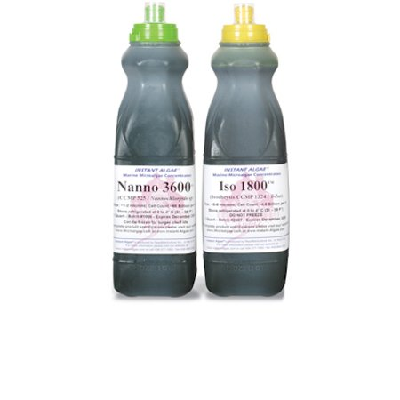
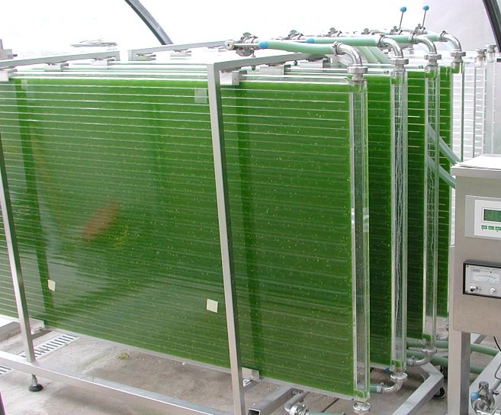
Grow and buy them
Live algae Labor intensive
Frozen algae expensive
Algae as suitable feed for Brachionus plicatilis and their source

Slide 26
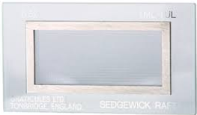
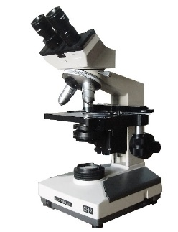
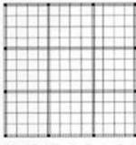
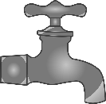
Process summary
Clean floss
Clean floss
Based on the numbers, culture will be doubled
Culture management
Cultures have to be counted daily to assess quality and quantity.
sedgewick rafter

Slide 27
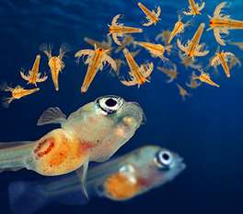
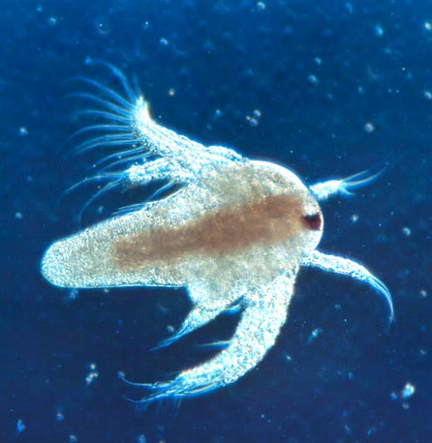
Artemia salina - Brine shrimp
Small crustaceans
Occurring in locations with high salinity
They are industrially mined from natural habitats and preserved
Very efficient filtrators (algae, diatoms, detritus, protozoa, bacteria)
Optimal nutritional composition for fish larvae
The nutritional composition of the Artemia:
Protein: 50-56%,
Fat: 12-23%,
Carbohydrate: 4-17%.
The composition varies depending on the locations and developmental stages.

Slide 28
Artemia salina - Brine shrimp
Two ways of reproduction:
- bisexual reproduction
- parthenogenesis
Suitable environmental conditions:
Live floating larvae are hatched directly from the ovaries
The female produces 50-250 cysts in one reproduction cycle
Unsuitable environmental conditions:
Very low or very high salinity
Females produce cysts

Slide 29
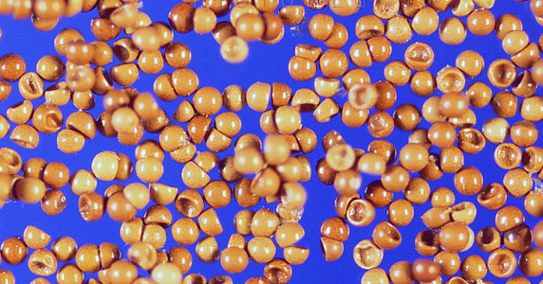
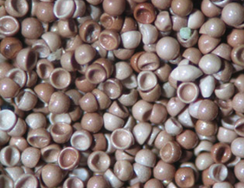
Artemia salina - Brine shrimp
Cysts - They are floating on the surface - Inactive and stop their development - Very resistant to environmental conditions

Slide 30
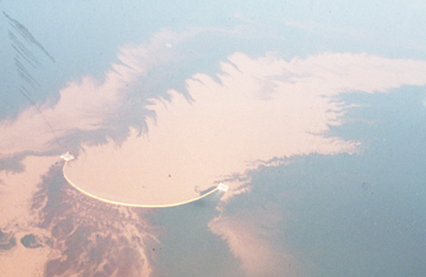
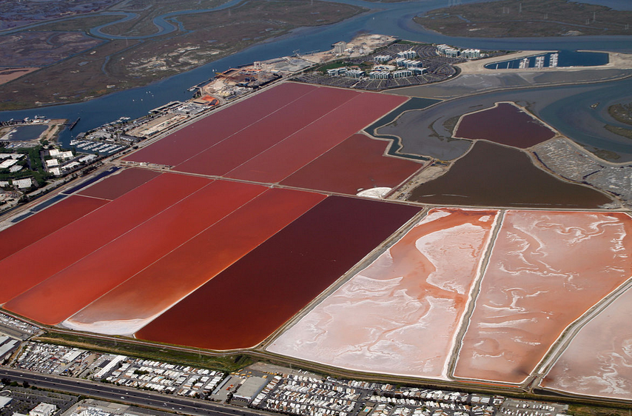
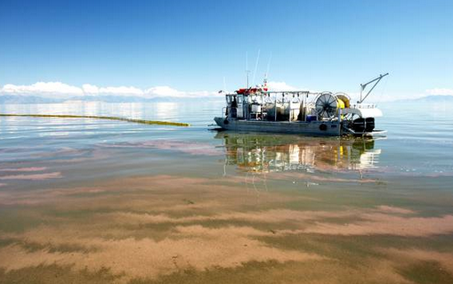
Artemia salina - Brine shrimp

Slide 31
Artemia salina - Brine shrimp
Development
Up to fifteen molting
Adult size is usually 1 - 1.2 cm
Females larger than males
Artemia growth stages – significant morphological differences
General development stages of Artemia:
A Cysts (after hydration);
B Hatching with nauplium, so-called. „umbrella“;
C Nauplium; D Metanauplium; E Adult.
Scale: A = 178 μm, B = 177 μm , C = 150 μm , D = 250 μm, E = 3,5 mm.

Slide 32
Artemia salina - Brine shrimp

Slide 33
Decapsulated Artemia
- Removing the top layer of the cyst
- Advantages:
: Cysts are disinfected : easy storage : cheaper : faster hatching : higher hatching in cyst with low hatching : Nutritional value of these cysts is not affected
- Disadvantage: immobile food
The decapsulated cysts can be stored for a long time
Savo, NaOH, hydrochloric acid (0.1 M HCl)

Slide 34
Incubation of Artemia – appropriate conditions
Temperature 28-29°C
Light
pH 8-9
Intensive aeration
Water salinity of 25 – 35 g.l⁻¹

Slide 35
Separation of Artemia shell - decapsulation
The shell of artemia contains iron (Fe)
Very easy cleaning
Special equipment required for separation (magnets)
Incubation is the same as normal
https://www.youtube.com/watch?v=kJhiiLugcjc

Slide 36
Advantages of artemia application
They occur in fish-free locations
Long shelf life of eggs stored in optimum conditions (cold and dry)
Easy and fast incubation
A suitable larval size for most fish requiring live first exogenous nutrition,
Movement,
Color,
Possibility to enrich for vitamins or probiotics

